Slide 1

ID Asg02 Pitch
Presenting SWiki/Star Wars Wiki
Done by: Lim Jia Wei P01

Slide 2

SWiki’s Purpose
Notes:
SWiki or Star Wars Wiki’s purpose is to be a site where anyone can visit to learn more about the Star Wars Universe and the characters in it.

Slide 3
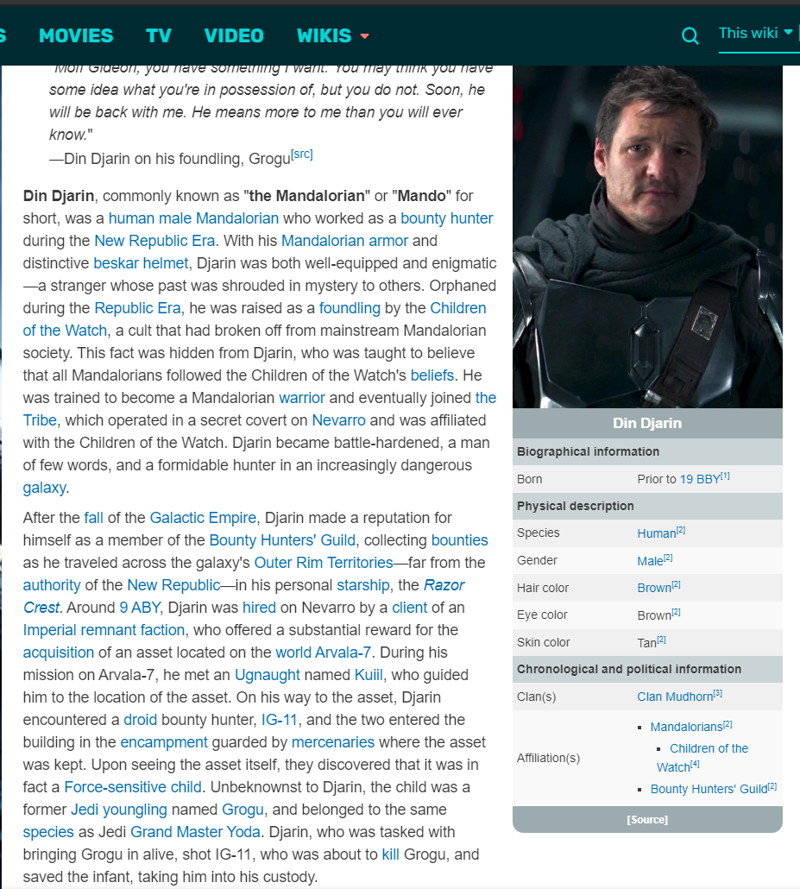
Design Process
Initial Idea for SWiki was to have each Star Wars character have its own page.
Idea changed to having several search functions instead
Dedicate a few pages to main categories of Star Wars
(Wookieepedia, 2021)
Notes:
The initial idea for Star Wars wiki was to have a page dedicated to each character. However, I decided against this as the assignment went on due to SWAPI (swa-pee), not being able to output an image of the character. I instead decided to create several search functions and dedicate a handful of pages to represent the films, games and TV series that are part of Star Wars

Slide 4
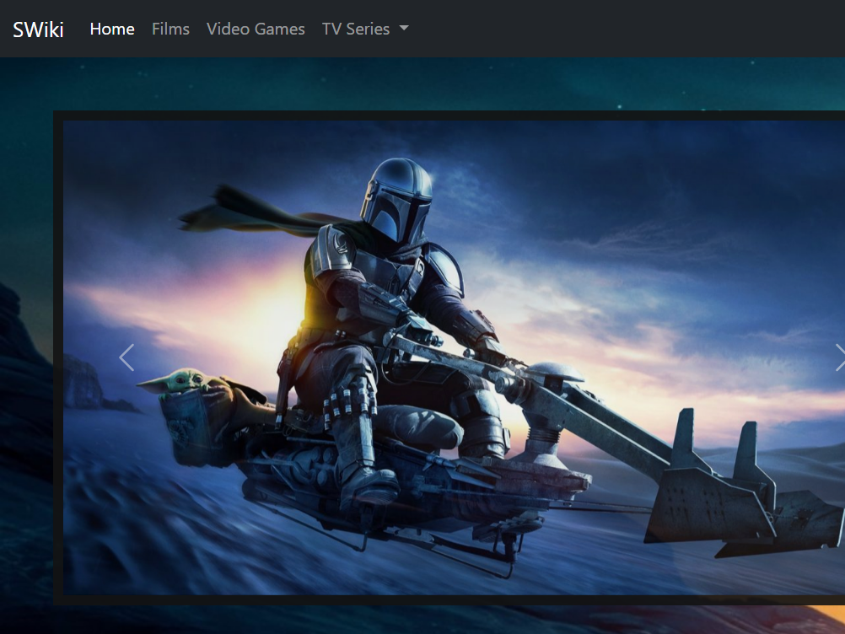
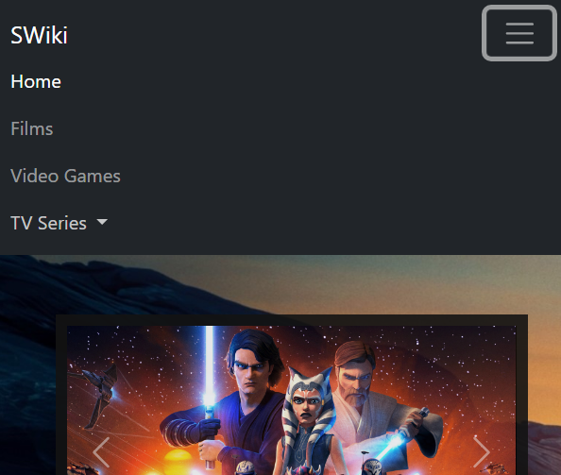
Features
Intuitive and Responsive Navigation Bar
Desktop
Mobile
Notes:
I used Bootstrap to implement

Slide 5
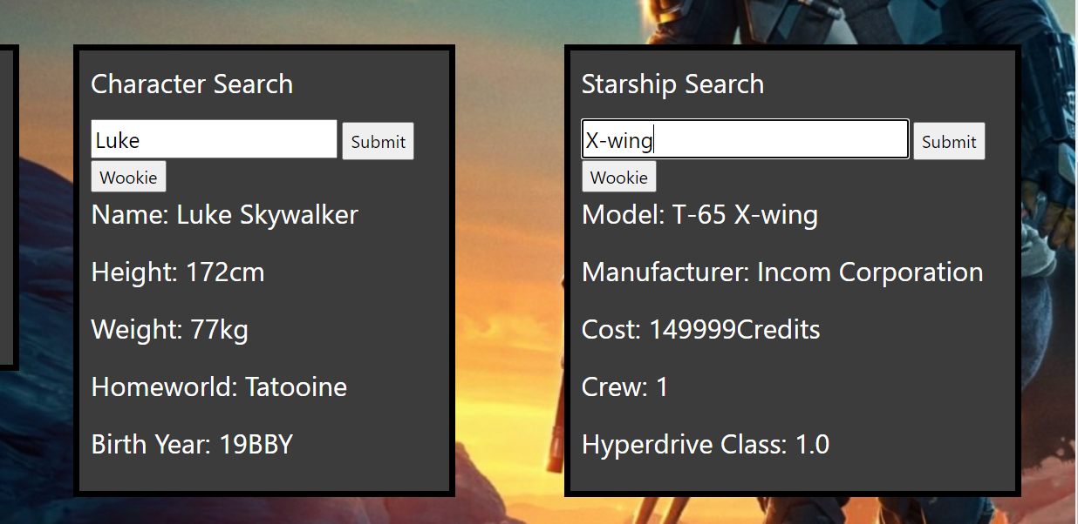
Features
Search Function ( Character, Species, Starship, Planet)
Notes:
I also implemented several search functions which can display the details characters, species, starships and even planets from the Star Wars Universe. I decided to add a “Wookie” version of the search functions which fetches the same data but in wookiee language from SWAPI. (swa-pee)

Slide 6
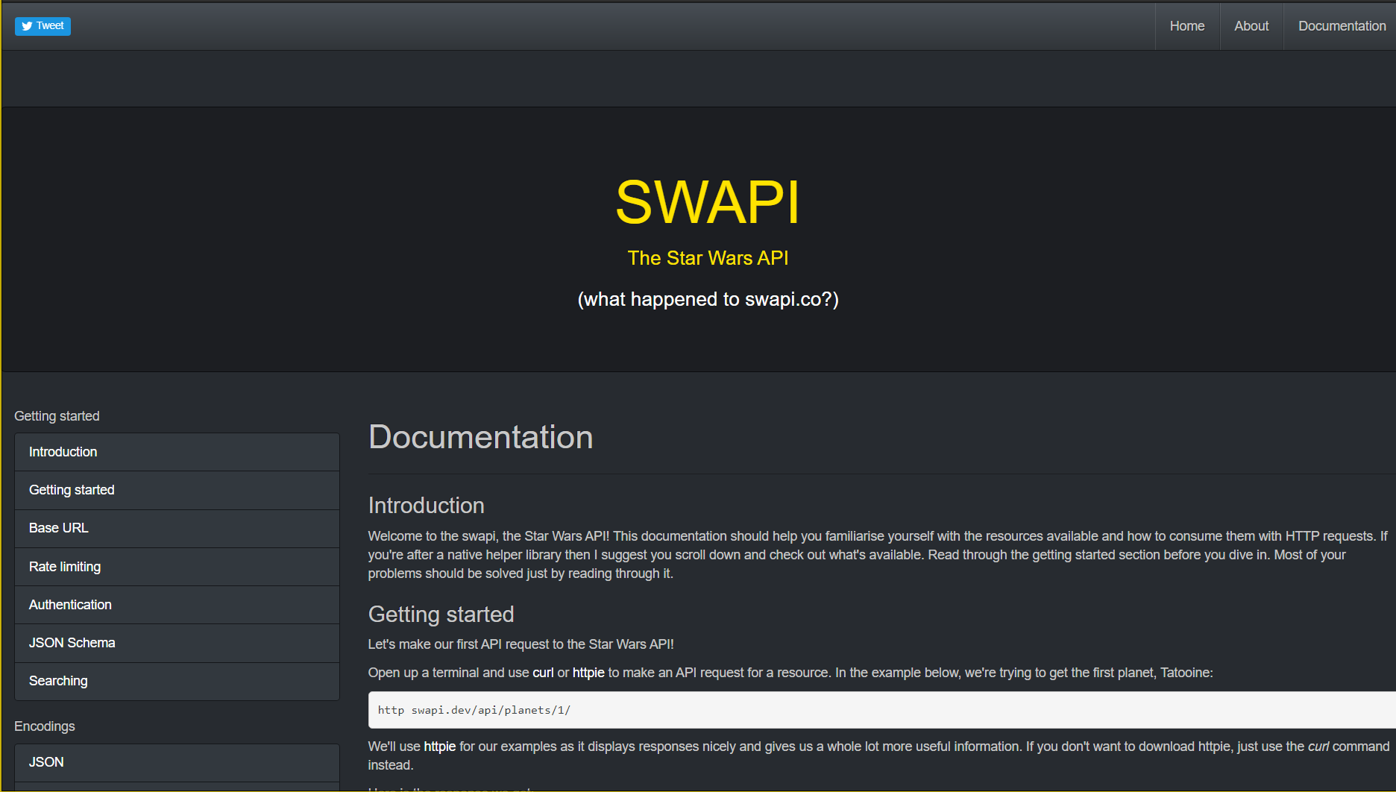
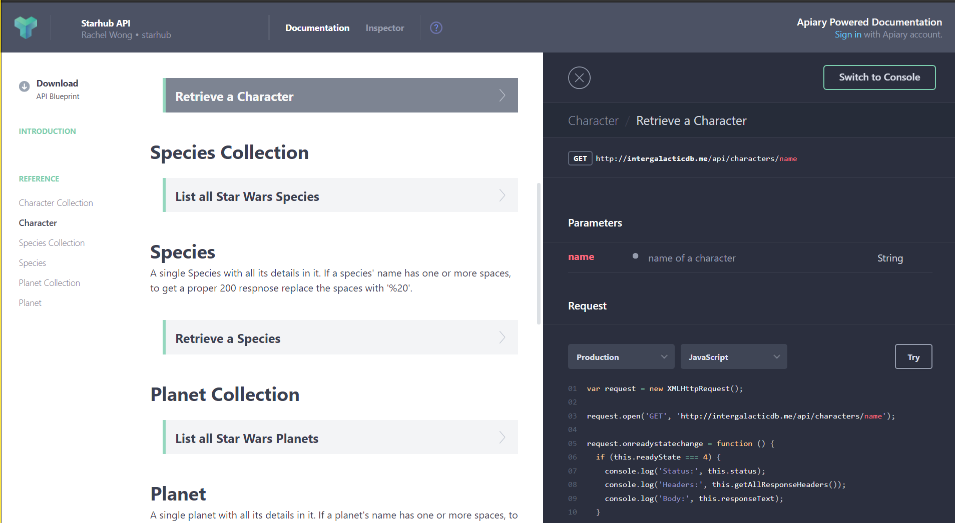
Choice Of API (SWAPI: The Star Wars API)
SWAPI vs Starhub (Why I chose SWAPI)

Slide 7
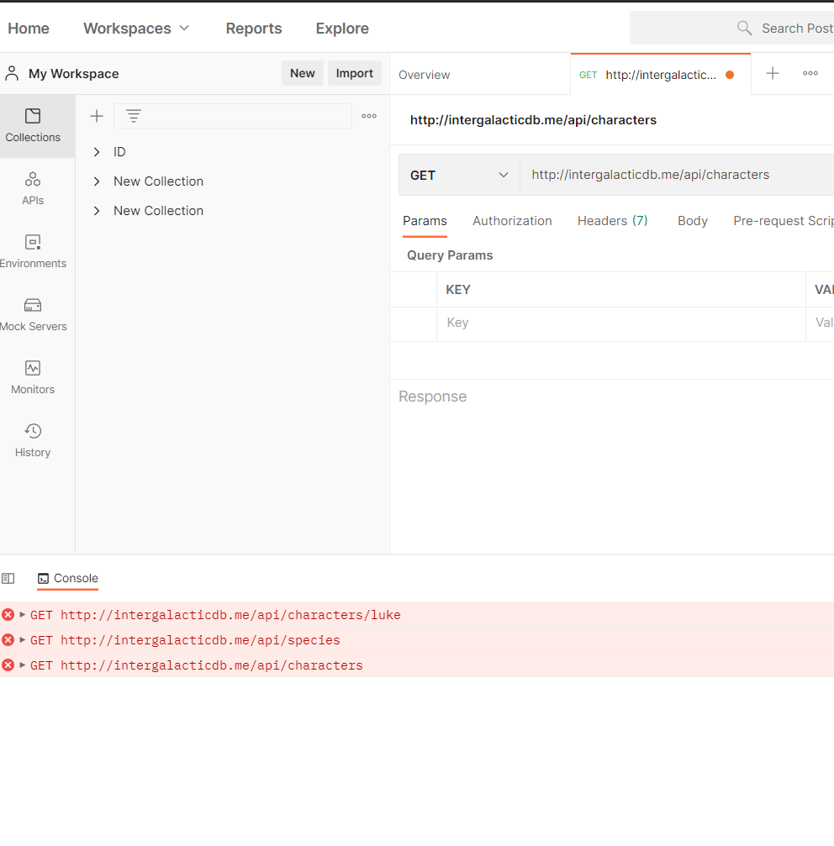
Problems With Starhub API
Though it does include images with its information, I could not retrieve any data (Failed GET request)

Slide 8
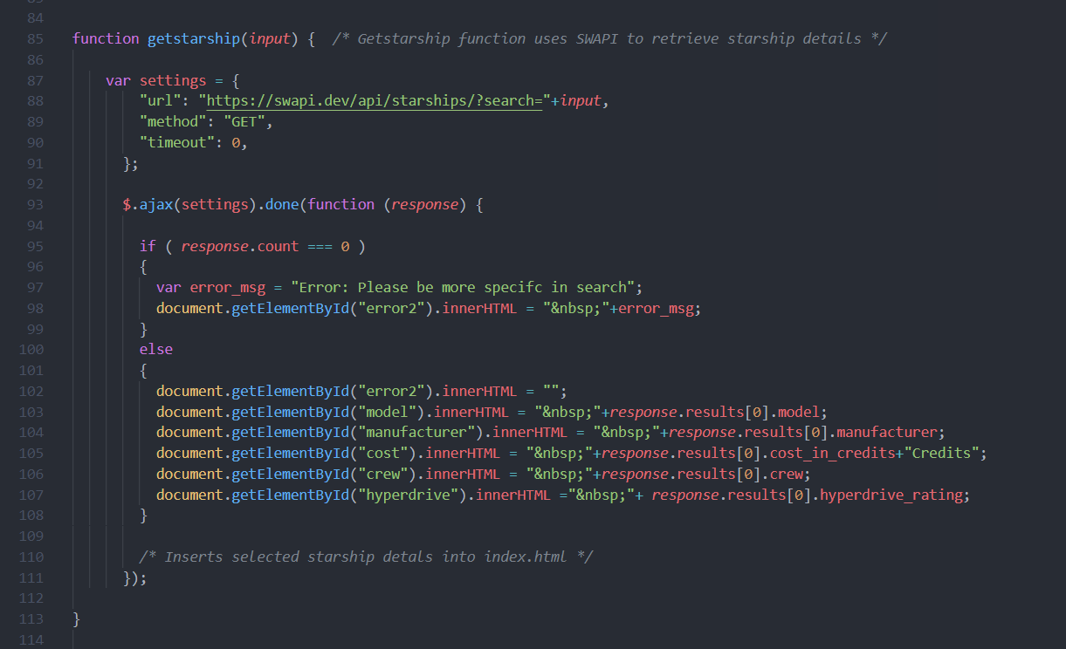
Example of SWAPI was utilized
Creating GET Request
Exception Handling
Utilizing innerHTML to insert information into pages

Slide 9
Credits
https://starwars.fandom.com/wiki/Din_Djarin

